Slide 1

Wandering Minds
APSARA - AI Predicted Stock Analysis of Relative Arbitrage
PUJA - Propensity Understanding & Jargon Analysis
LOI - Language Oriented Interaction

Slide 2
APSARA
AI Predicted Stock Analysis of Relative Arbitrage

Slide 3
The problem
Problem
Context
Problem statement
Predicting stock analysis of Relative stocks using AI and Machine learning.
Few stocks follow specific pattern based on INDEX.
We can relate these stocks to get predictive analysis.
Predicting BANKNIFTY percentage change using percentage change of AXIS BANK , ICICI BANK and HDFC BANK

Slide 4
Challenges deep-dive
Getting Stocks Data
Training Machine to Predict Stocks
Running Perceptron Network
Getting BANKNIFTY and BANK Relative data
Getting 1 yr data of BANKNIFTY and deriving percentage change from that. Deriving other banks data and their respective % change.
Creating data set to train Machine for data prediction
Quantize the % change data and pass it to Neural network for training. Handle +ve/-ve % change:
Added 1 extra bit = 1: +ve, 0: -ve
12, 8, 4 perceptron network [InputLayer(12), HiddenLayer(8), OutputLayer(4)]
Input:
Relative %change value of 3 banks
Output:
Relative %change of BankNifty

Slide 5
Solution
We have created a platform which analyses the percentage change data to predict relative BankNifty data.
APSARA - AI Predicted Stock Analysis of Relative Arbitrage

Slide 6
Implementation

Slide 7
Finding relation between multiple stocks wrt percentage change
Getting historical data
Creating training set
Stage 1
Stage 2
Stage 3
Stage 4
Stage 5
Calculating Percentage change
Quantizing the data

Slide 8
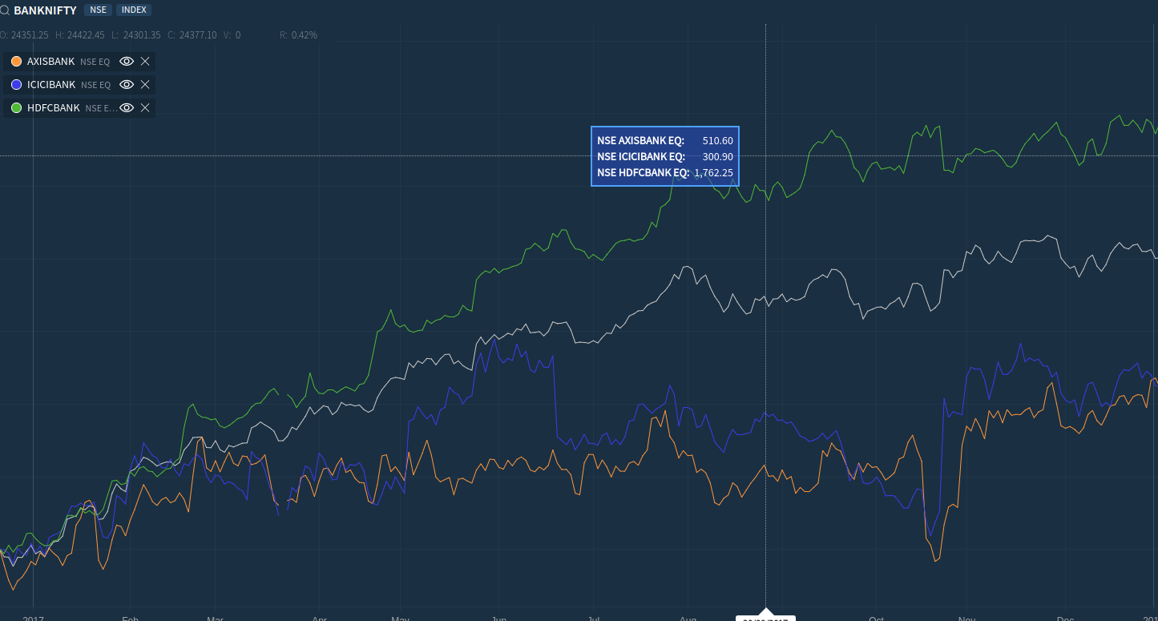
Original Output

Slide 9
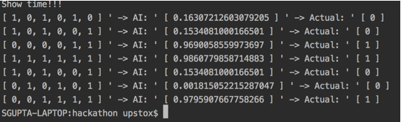
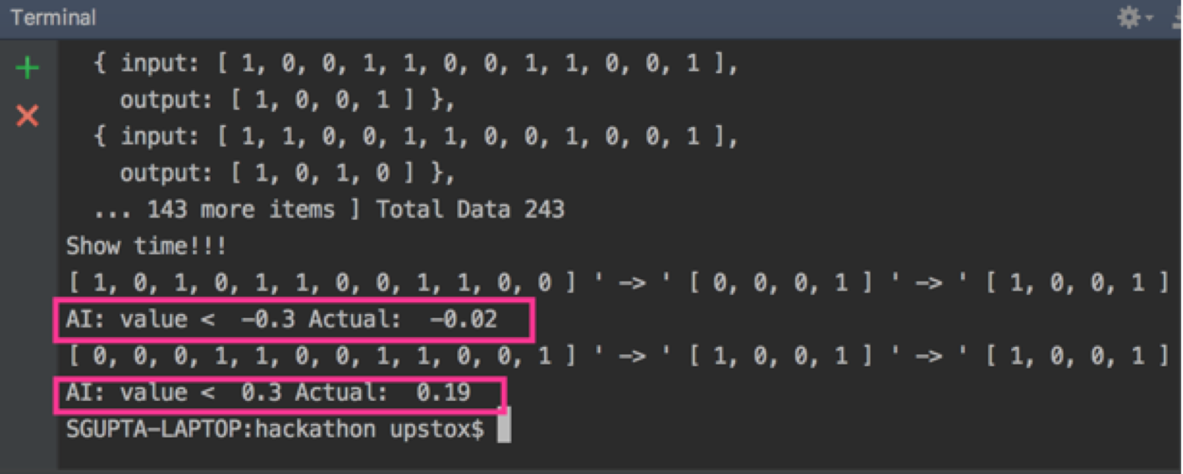
Our Output

Slide 10
PUJA
Propensity Understanding & Jargon Analysis

Slide 11
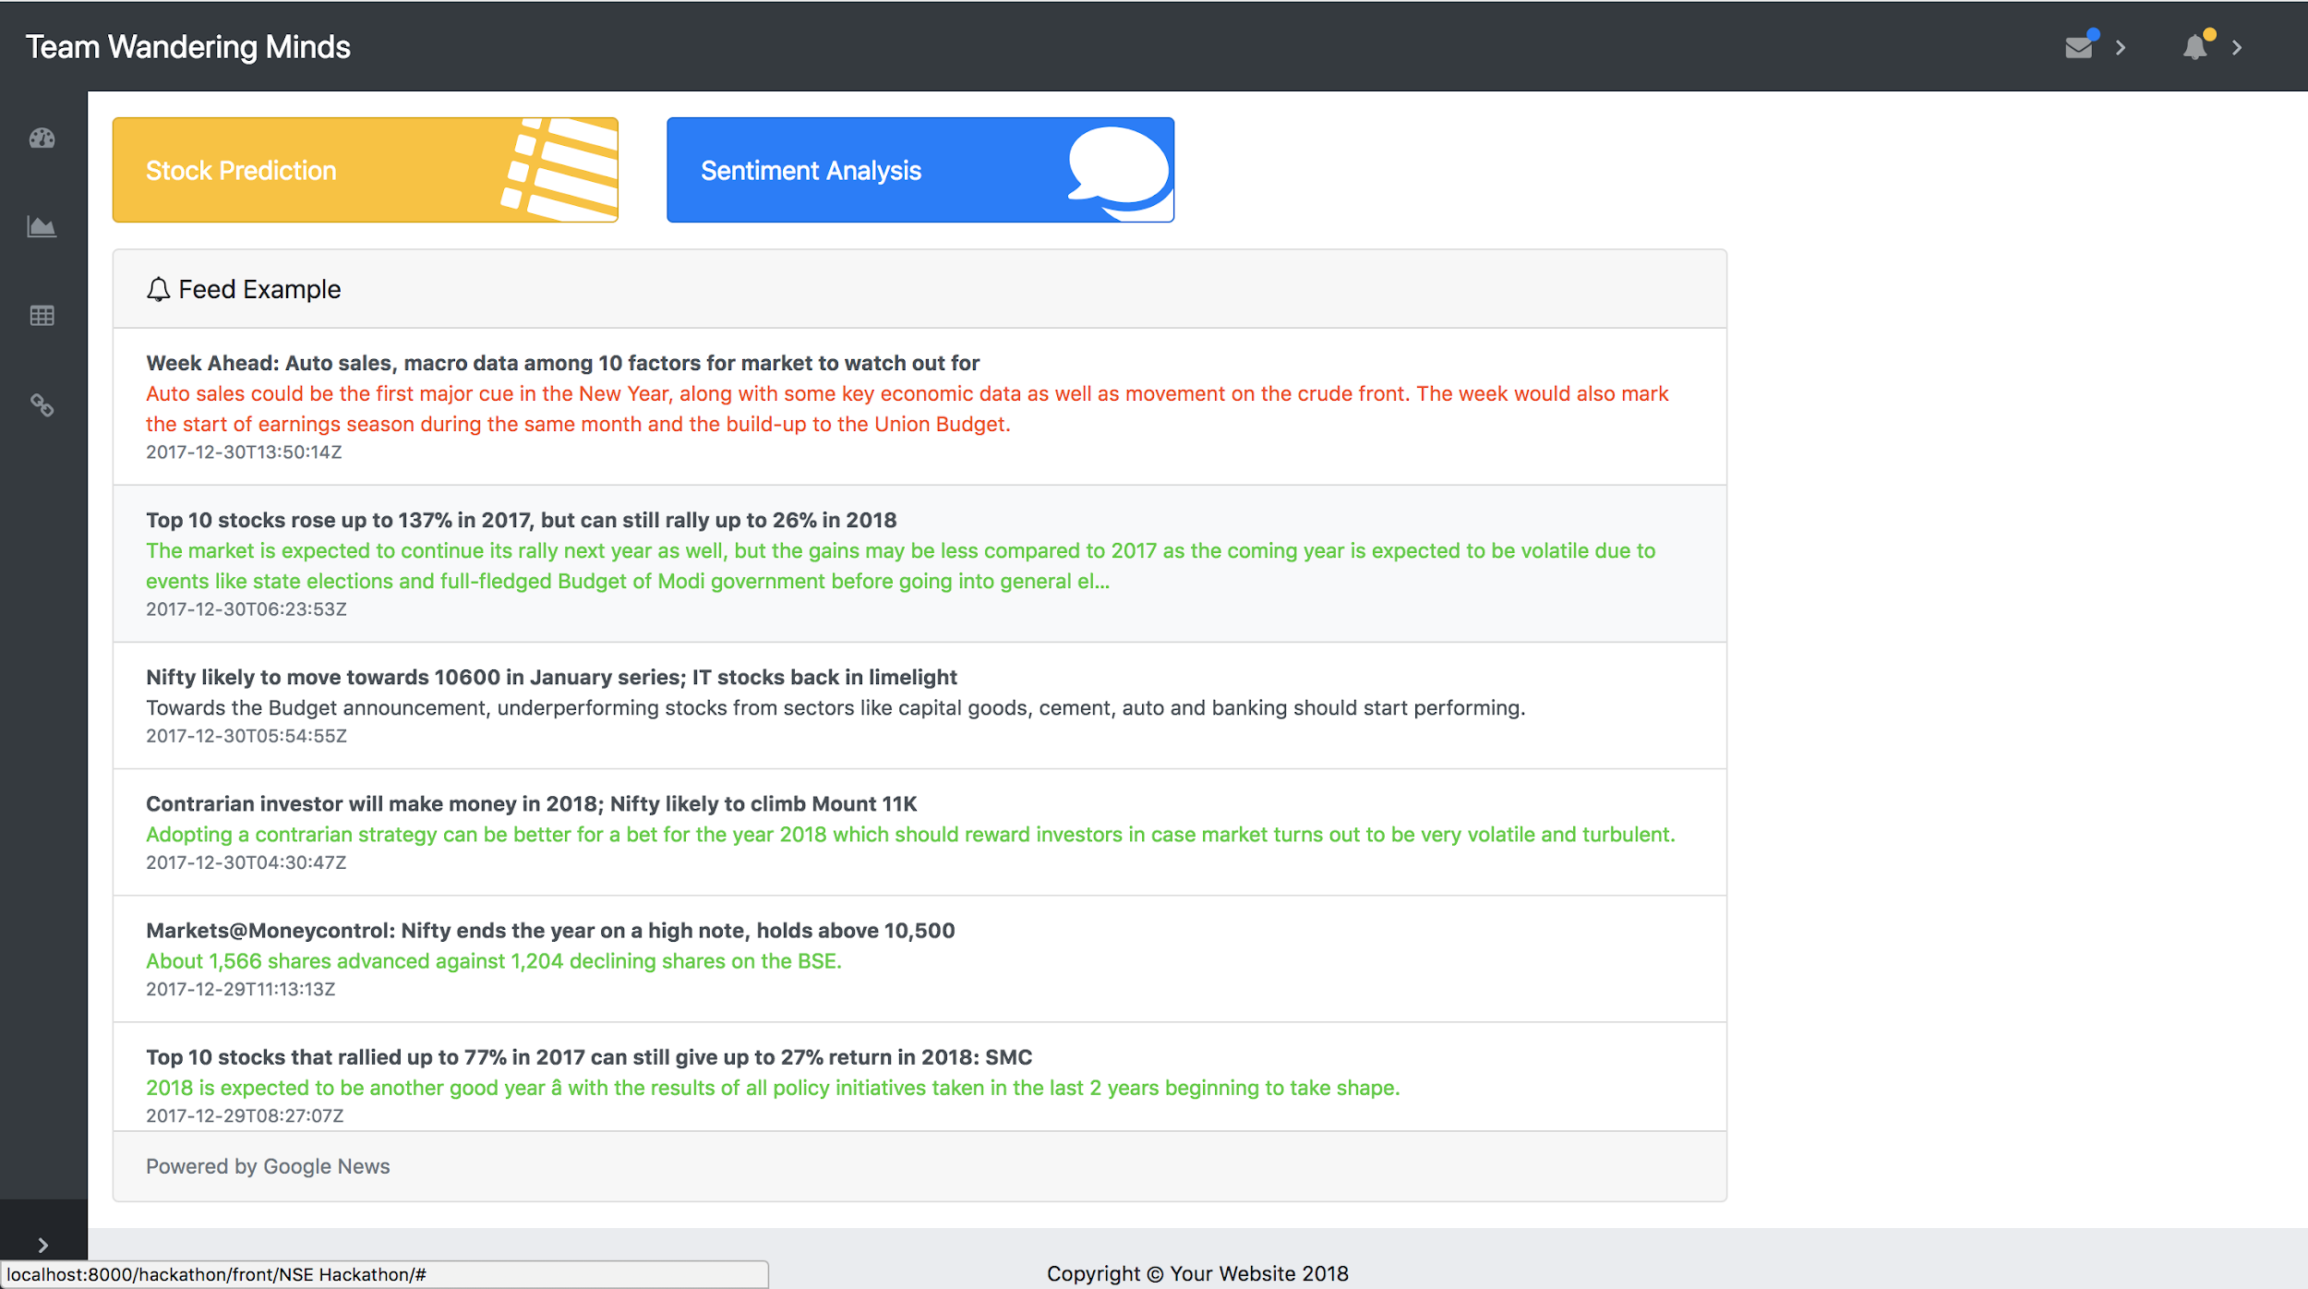
PUJA - Output

Slide 12
LOI
Language Oriented Interaction

Slide 13
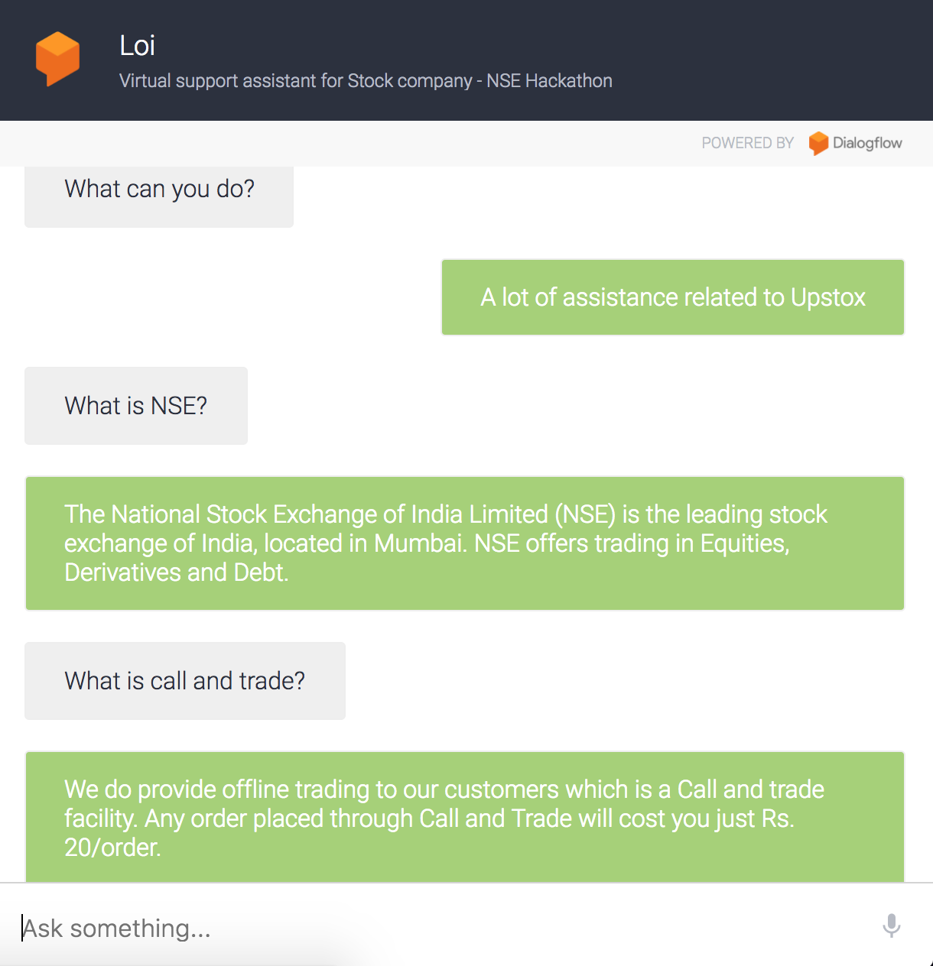
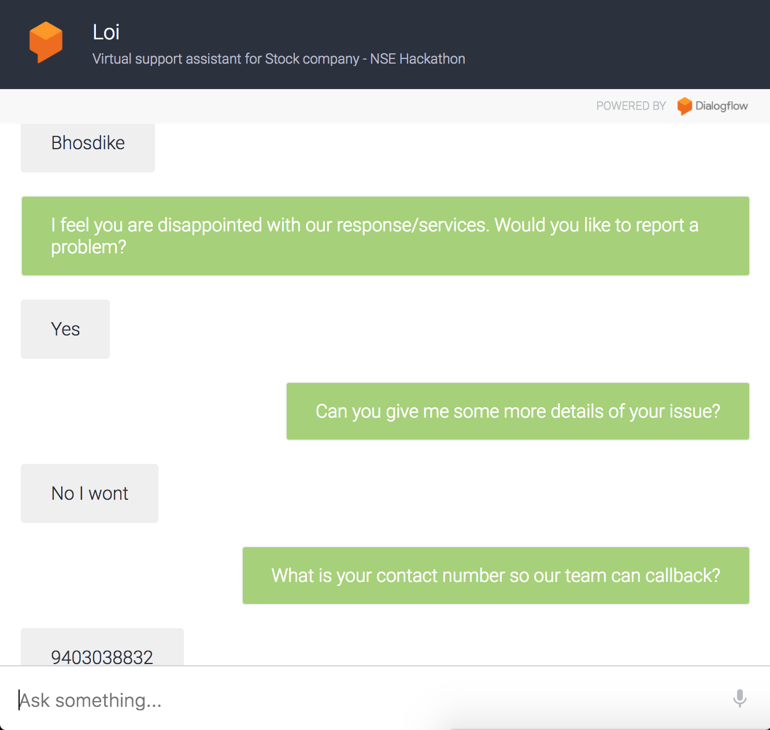
Loi - Output

Slide 14
Wandering Minds
Aniket
Alok
Archana
Bala
Jivan
Rishab
Suraj
Suryaprakash
Vinayak

Slide 15
Thank You !!!

